Slide 1
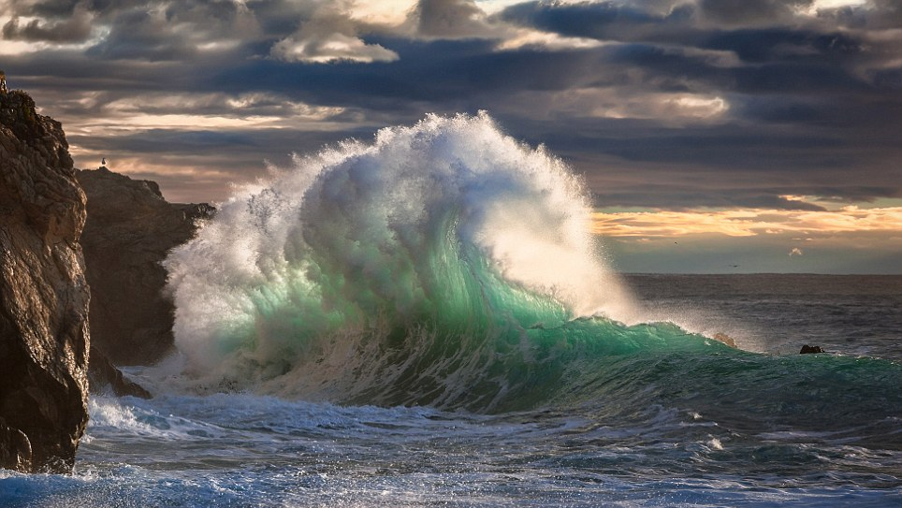
Marine Genomics
Welcome!
Notes:
Introduction, syllabus, and survey

Slide 2
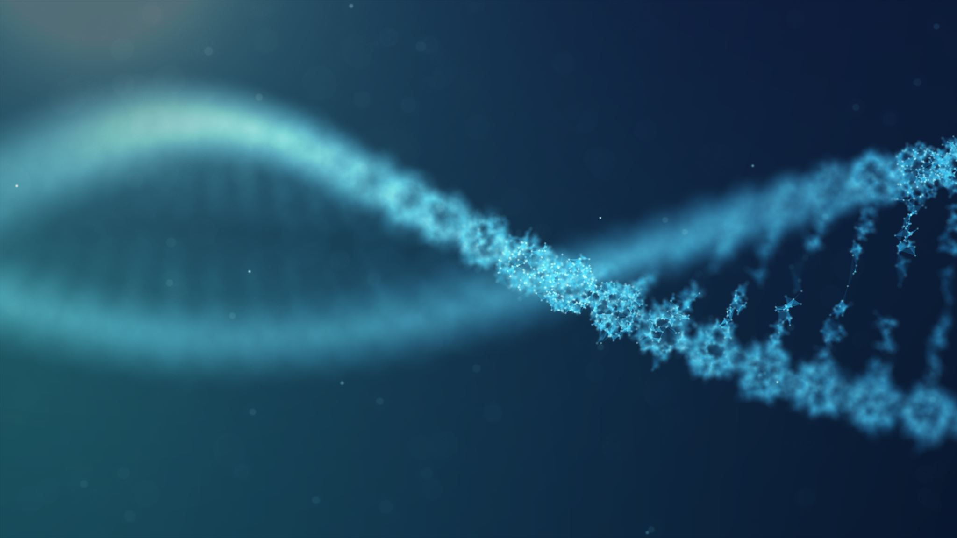
What is Marine Genomics?
Using genomic data to answer questions about the evolutionary biology of marine organisms.

Slide 3
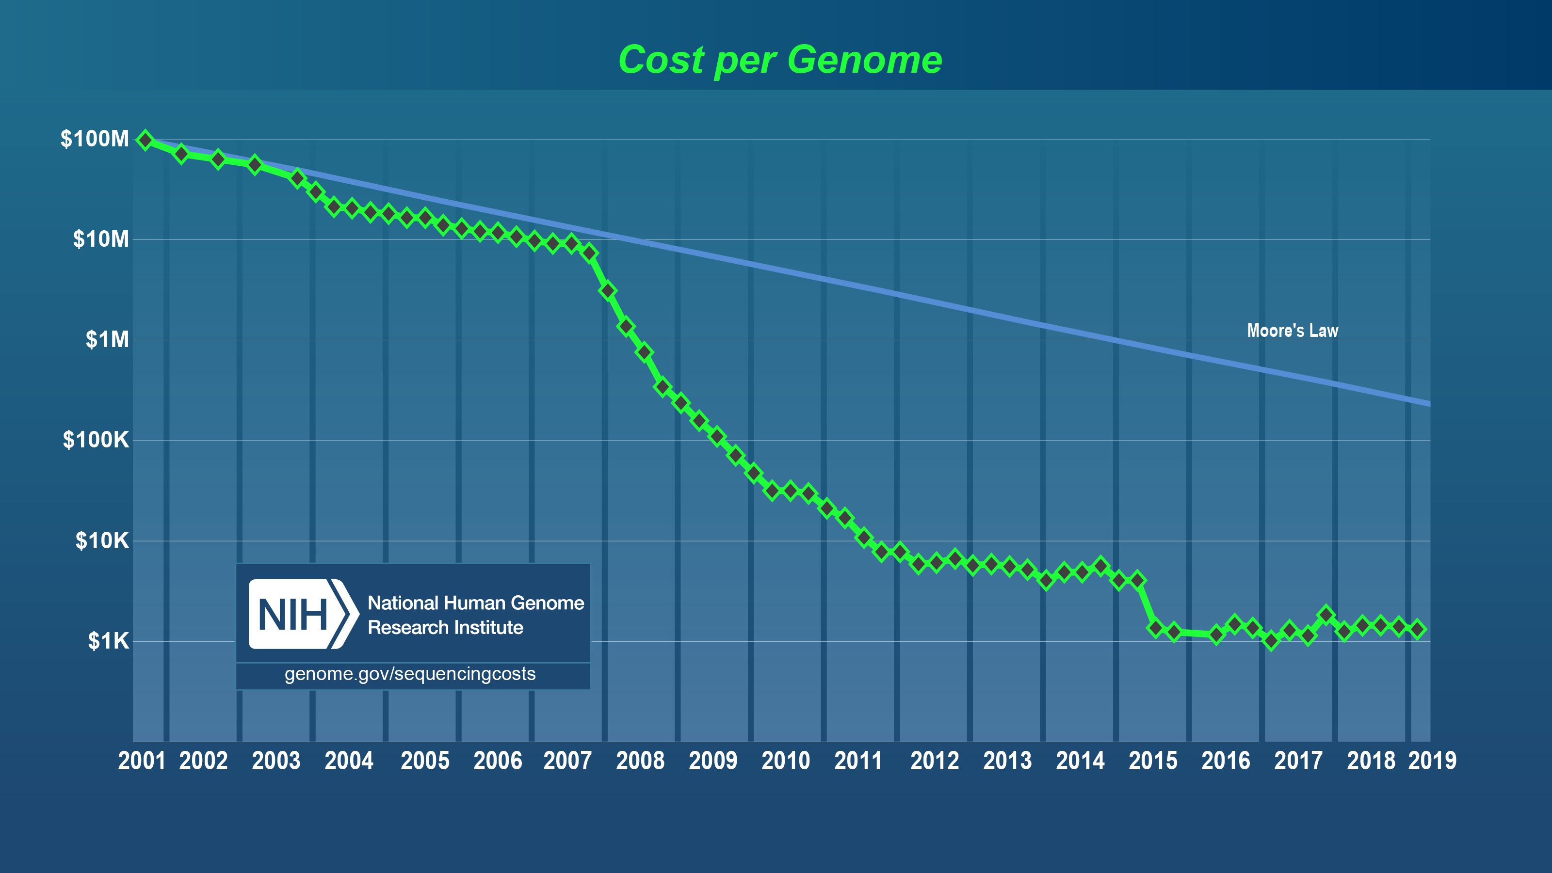
Genomic data is becoming more and more accessible ( == cheaper)
Notes:
Moore's Law refers to Moore's perception that the number of transistors on a microchip doubles every two years, though the cost of computers is halved. Moore's Law states that we can expect the speed and capability of our computers to increase every couple of years, and we will pay less for them.

Slide 4
Major evolutionary questions in Marine Biology
What limits range size? Is there local adaptation at a species range limits?
What influences patterns of gene flow and migration and how does gene flow and migration impact selection or local adaptation?
What are the primary selective factors shaping phenotypic variation?

Slide 5

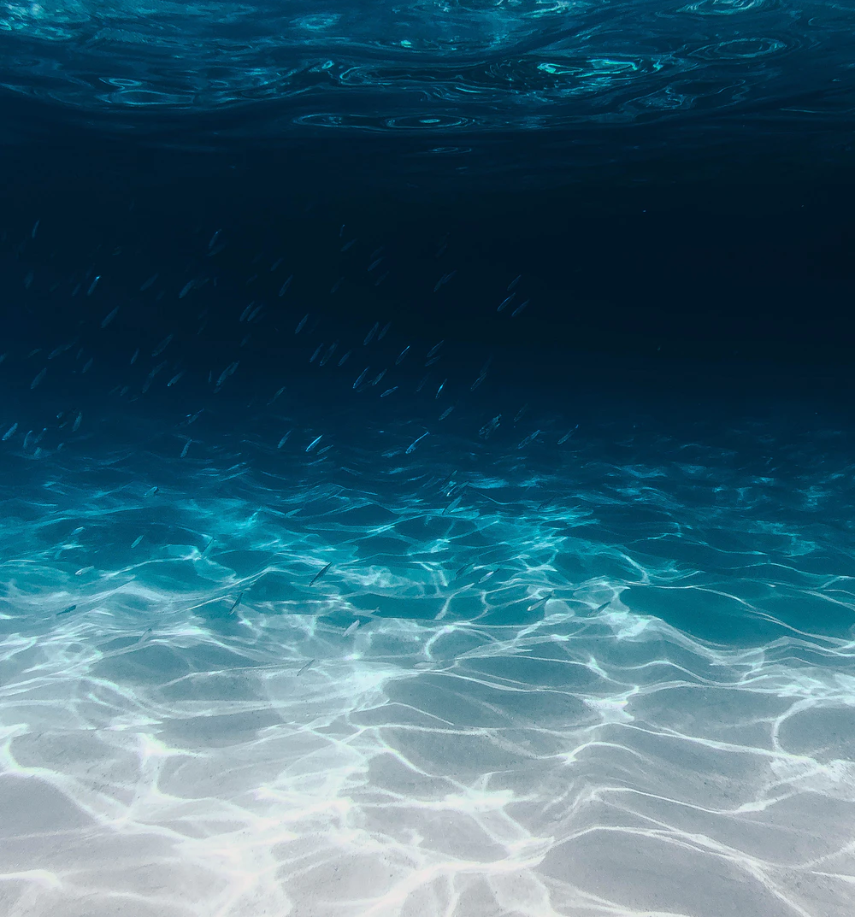
What is Marine Genomics?
Genotype
Seascape genomics
Ecological genomics
Environment
Phenotype
Figure modified from: https://link.springer.com/article/10.1007/s11295-013-0596-x
Notes:
Highlight that natural selection operates on phenotypes (whose expression is modulated by the environment) but that change over time (evolution) requires genetic variants to be associated with those phenotypes and to be passed down to offspring.

Slide 6
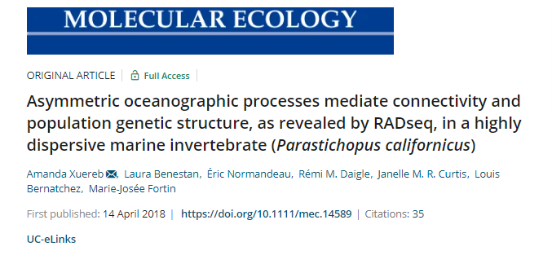
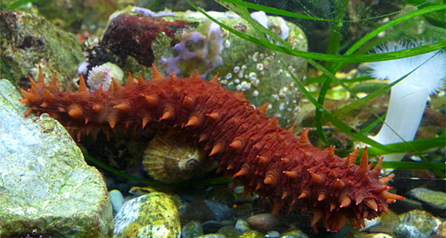
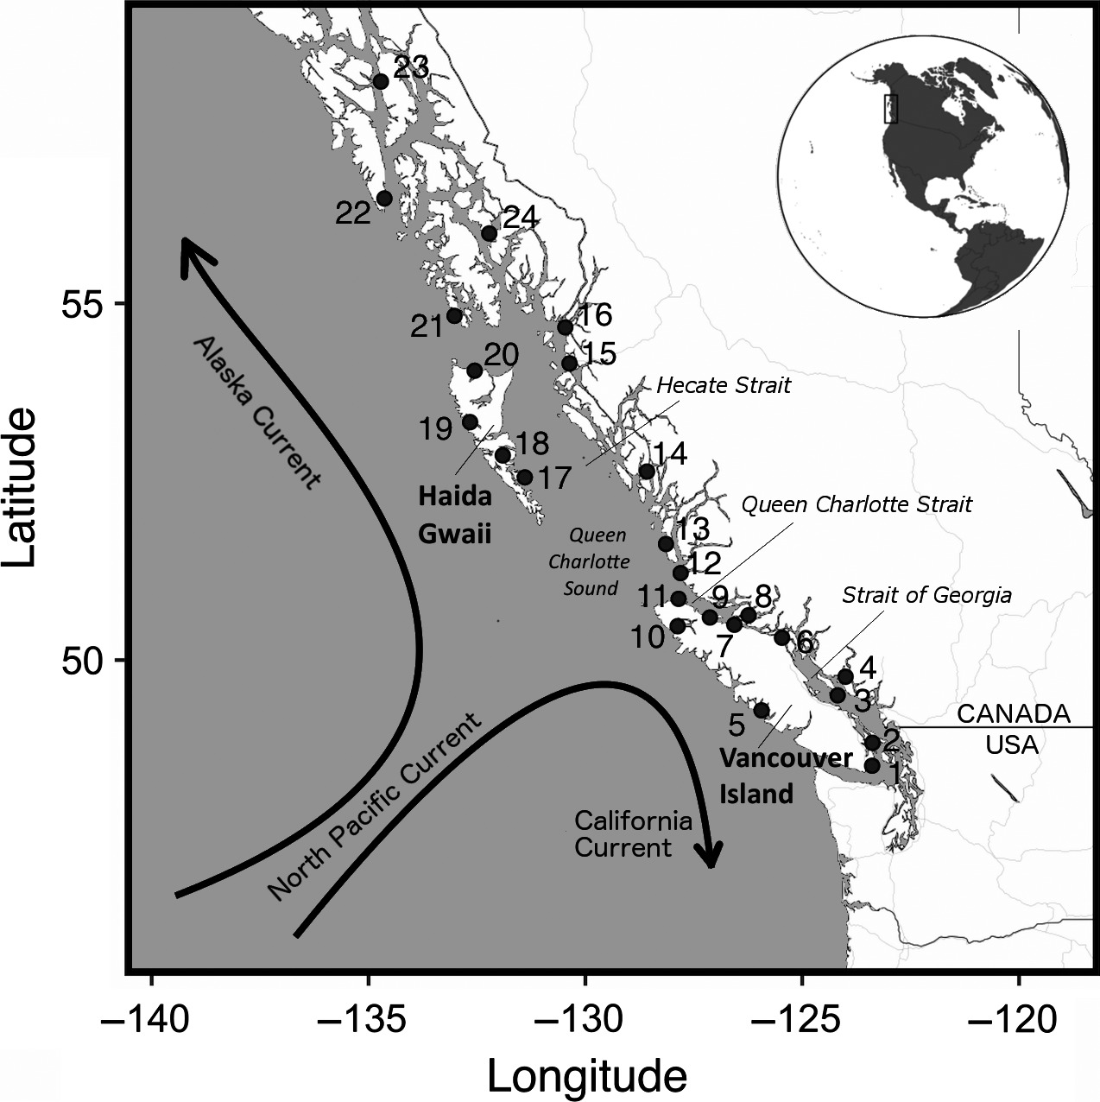
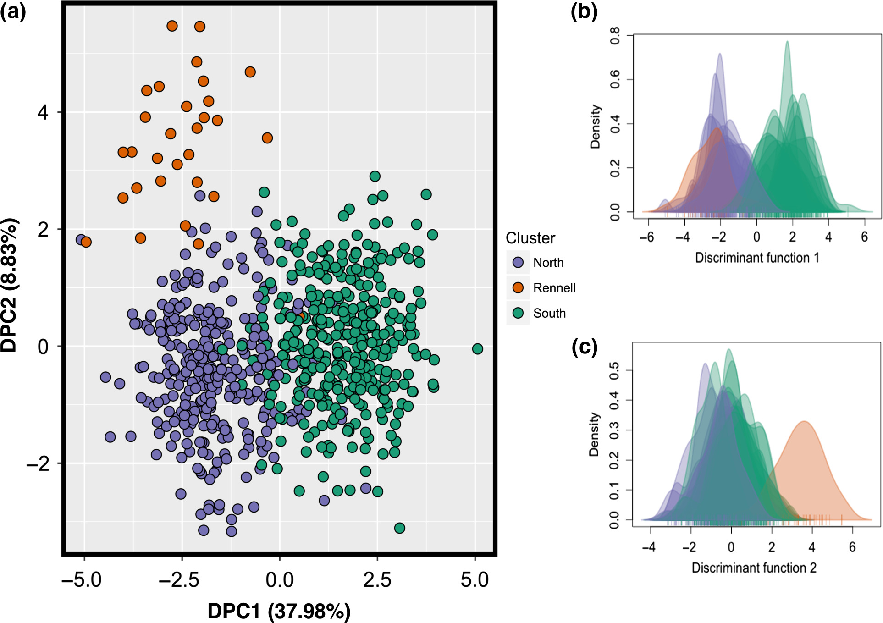
Notes:
Highlight genotype and environment interactions
http://www2.bio.ulaval.ca/louisbernatchez/pdf/(417)%20Xuereb_Molecular_Ecology_2018.pdf
https://pubmed.ncbi.nlm.nih.gov/29654703/

Slide 7
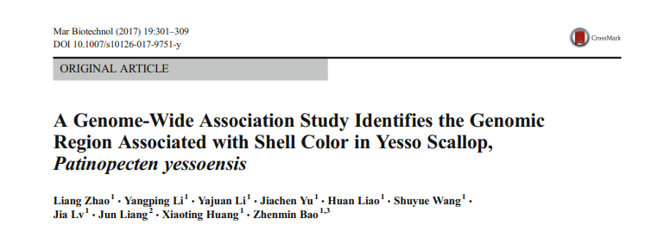
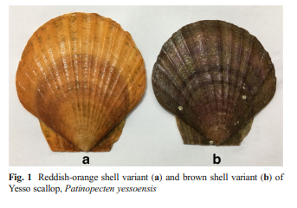
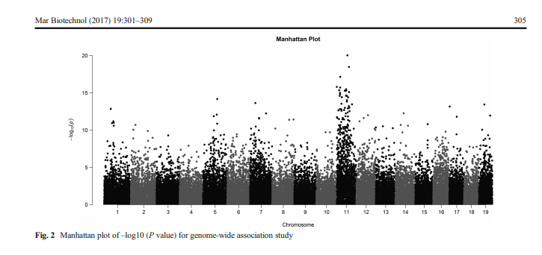
Notes:
https://link.springer.com/article/10.1007/s10126-017-9751-y#Bib1
Genotype and phenotype

Slide 8
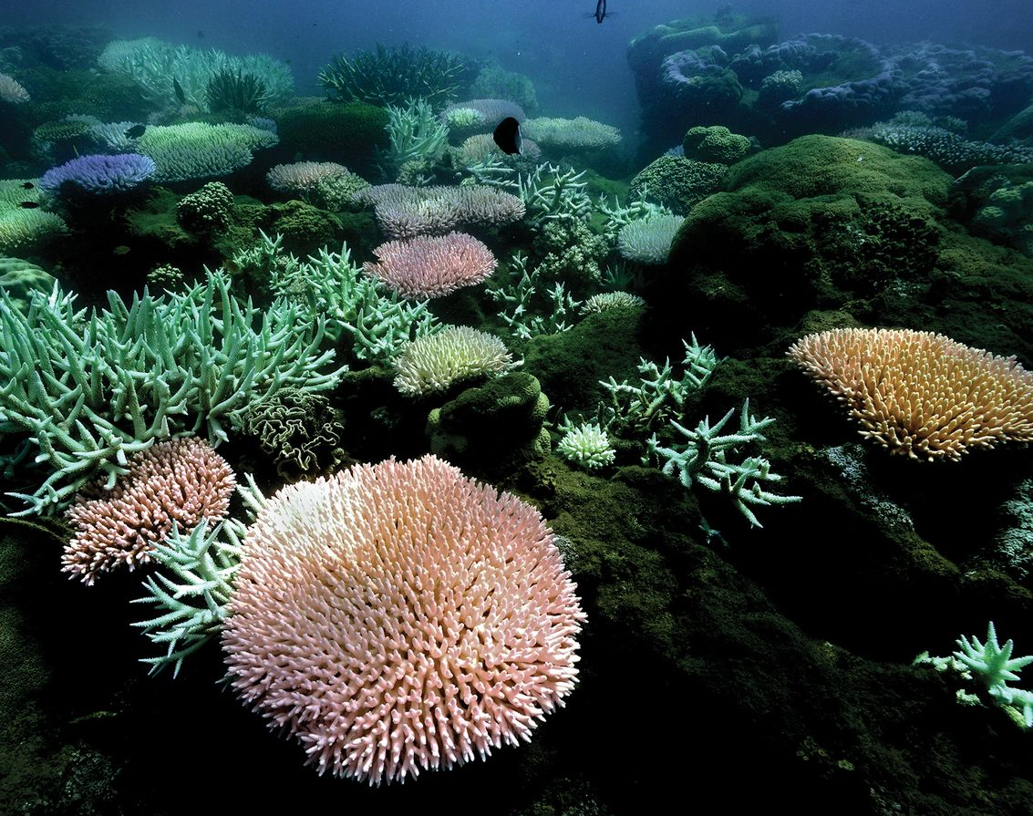
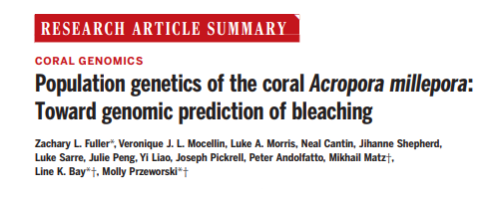
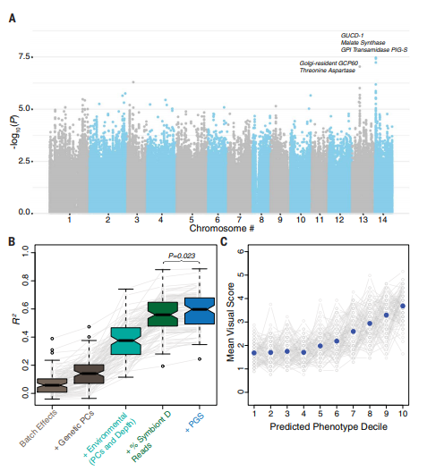
Notes:
https://science.sciencemag.org/content/sci/369/6501/eaba4674.full.pdf
A paper that does all three and with an applied goal.

Slide 9
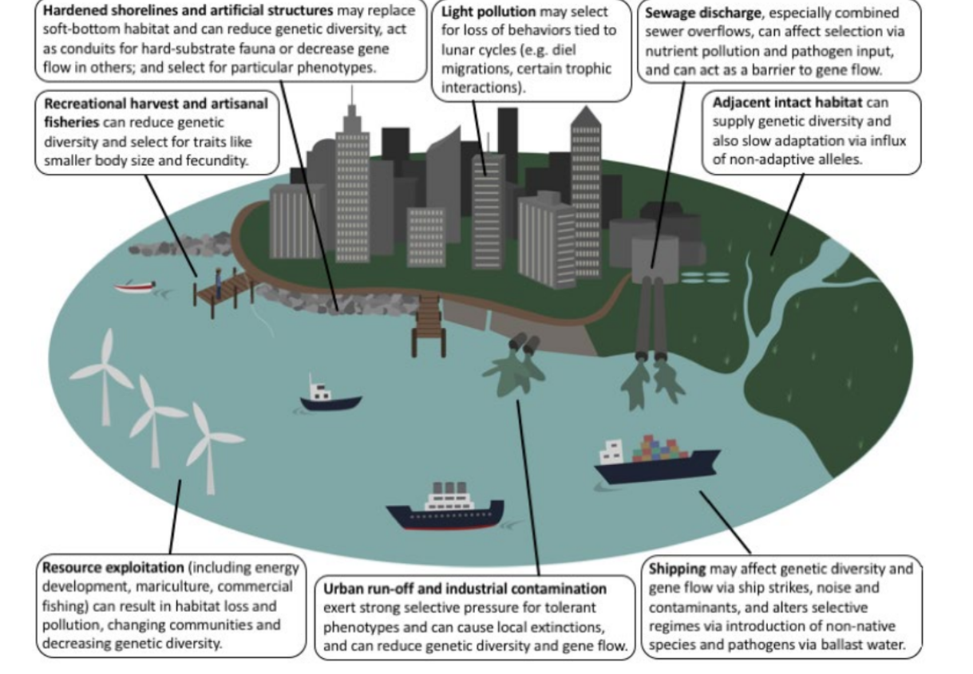
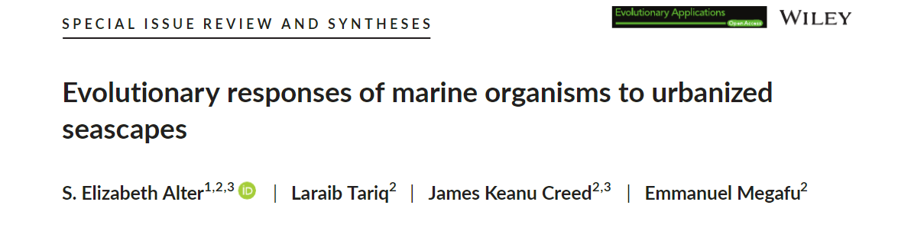

Slide 10
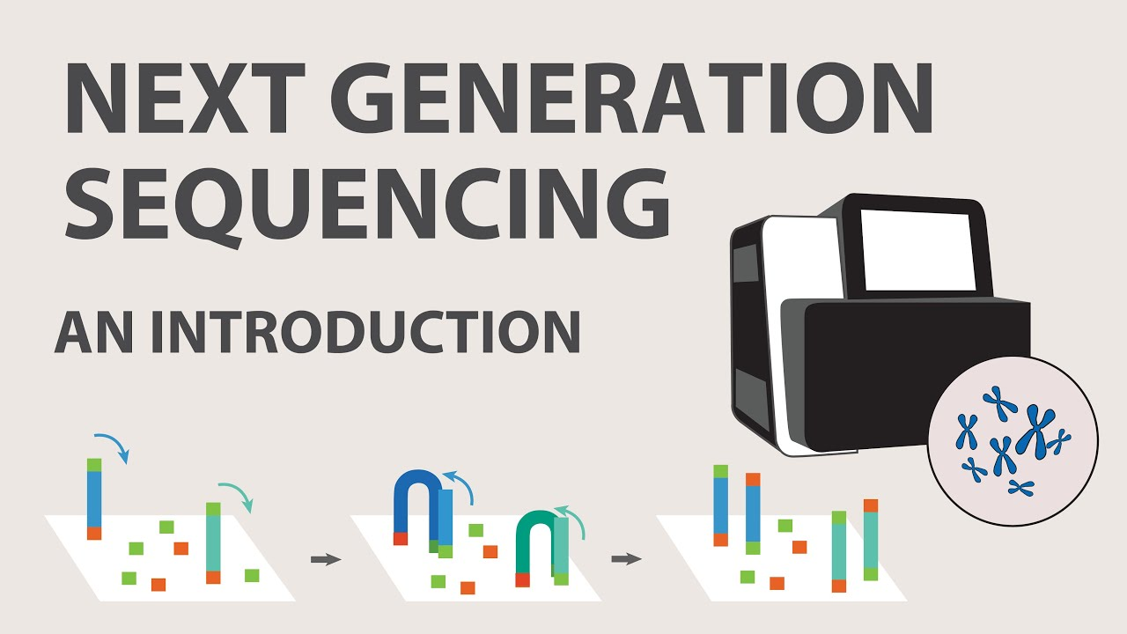
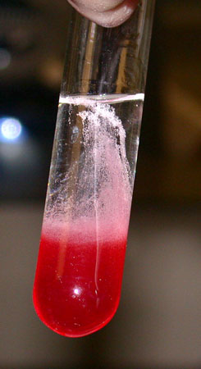
How do we do marine genomics?
Research idea/question
Design experiment
Lab experiment
Field collection scheme
Perform analyses
Download data
Present results at conference
Publish paper
Extract DNA/RNA
https://www.youtube.com/watch?v=jFCD8Q6qSTM&ab_channel=AppliedBiologicalMaterials-abm
Notes:
All are interrelated. We will focus on performing analyses (which includes visualizing your data and doing statistical analyses)

Slide 11
We use bioinformatics to answer these questions
We’ll cover two main areas
The shell or Bash/UNIX
R
Many of these analyses are very computationally intensive

Slide 12
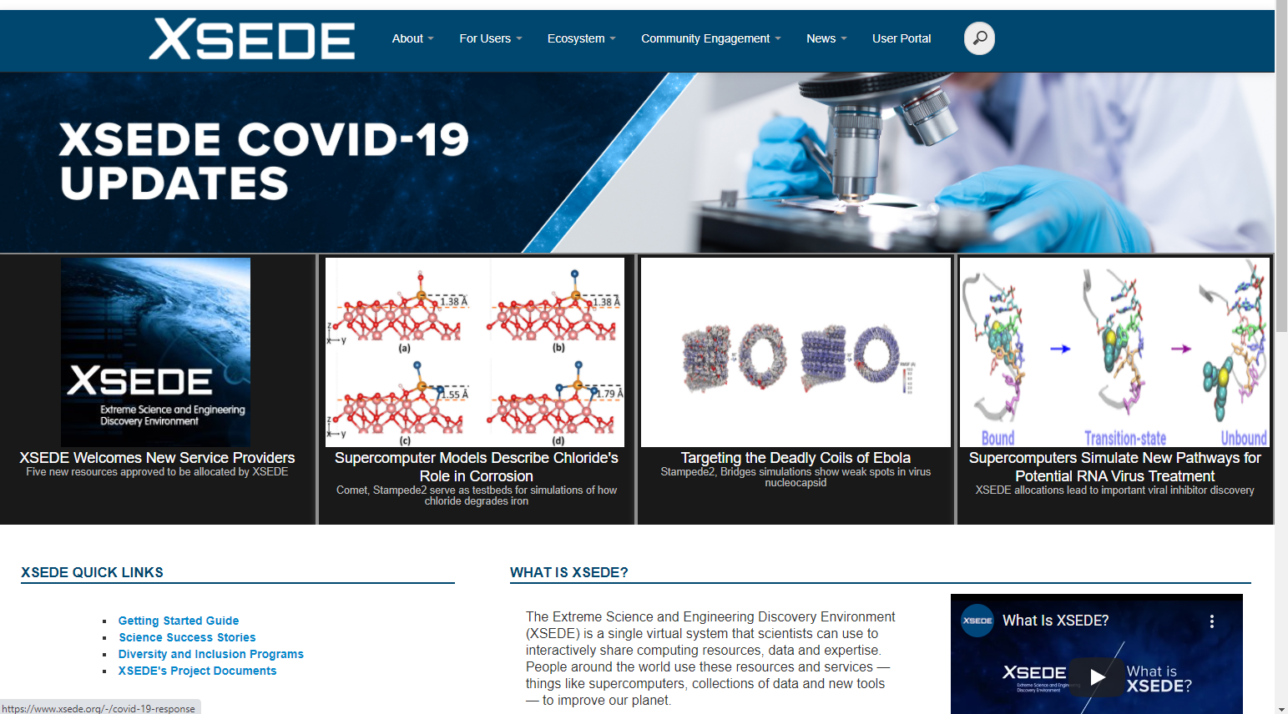
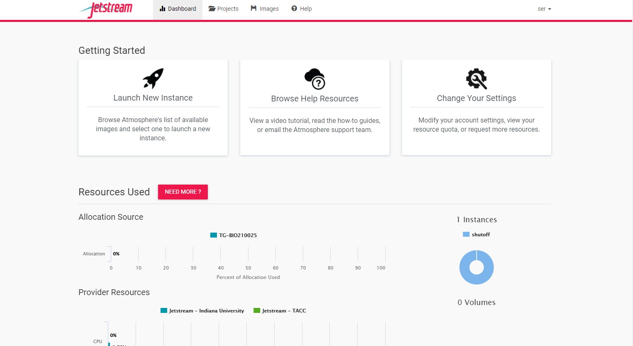
Jetstream via xsede
Notes:
https://use.jetstream-cloud.org/application

Slide 13
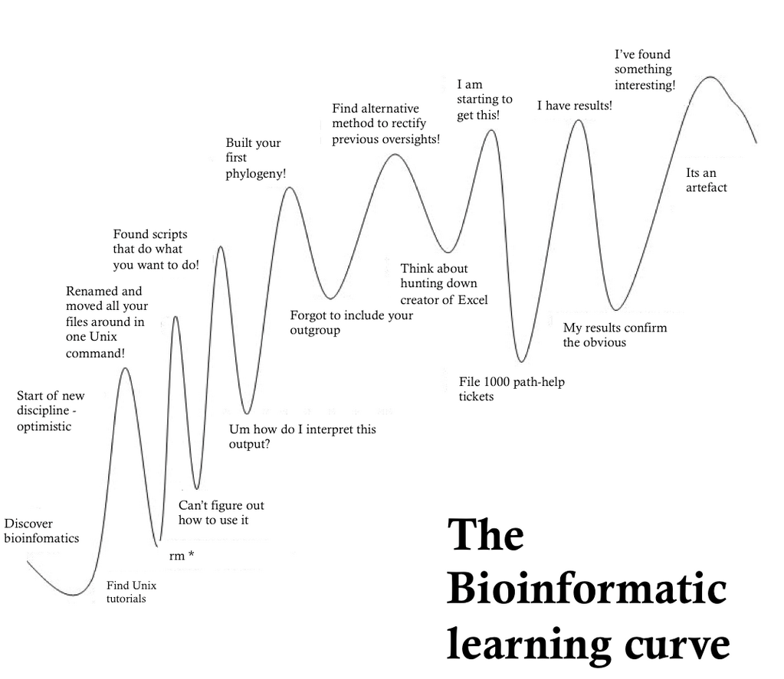
Source: https://images.app.goo.gl/9Z2yoRSwwNG9iNhu6

Slide 14
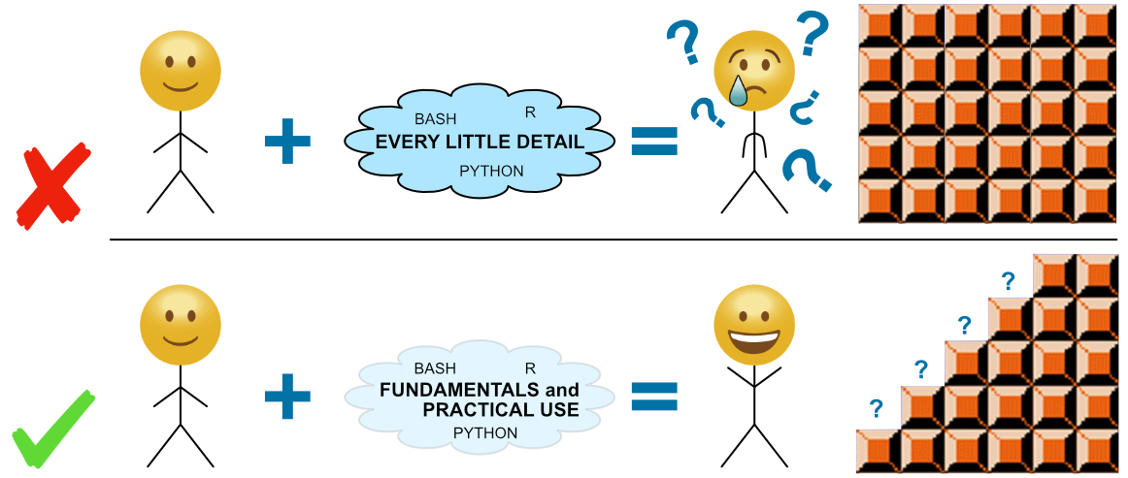
Source: https://www.google.com/url?sa=i&url=https%3A%2F%2Fastrobiomike.github.io%2Fabout%2F&psig=AOvVaw0RKmkNIIBkA5hP7oX73zI2&ust=1616086599613000&source=images&cd=vfe&ved=0CAIQjRxqFwoTCOCYxe_lt-8CFQAAAAAdAAAAABAX

Slide 15
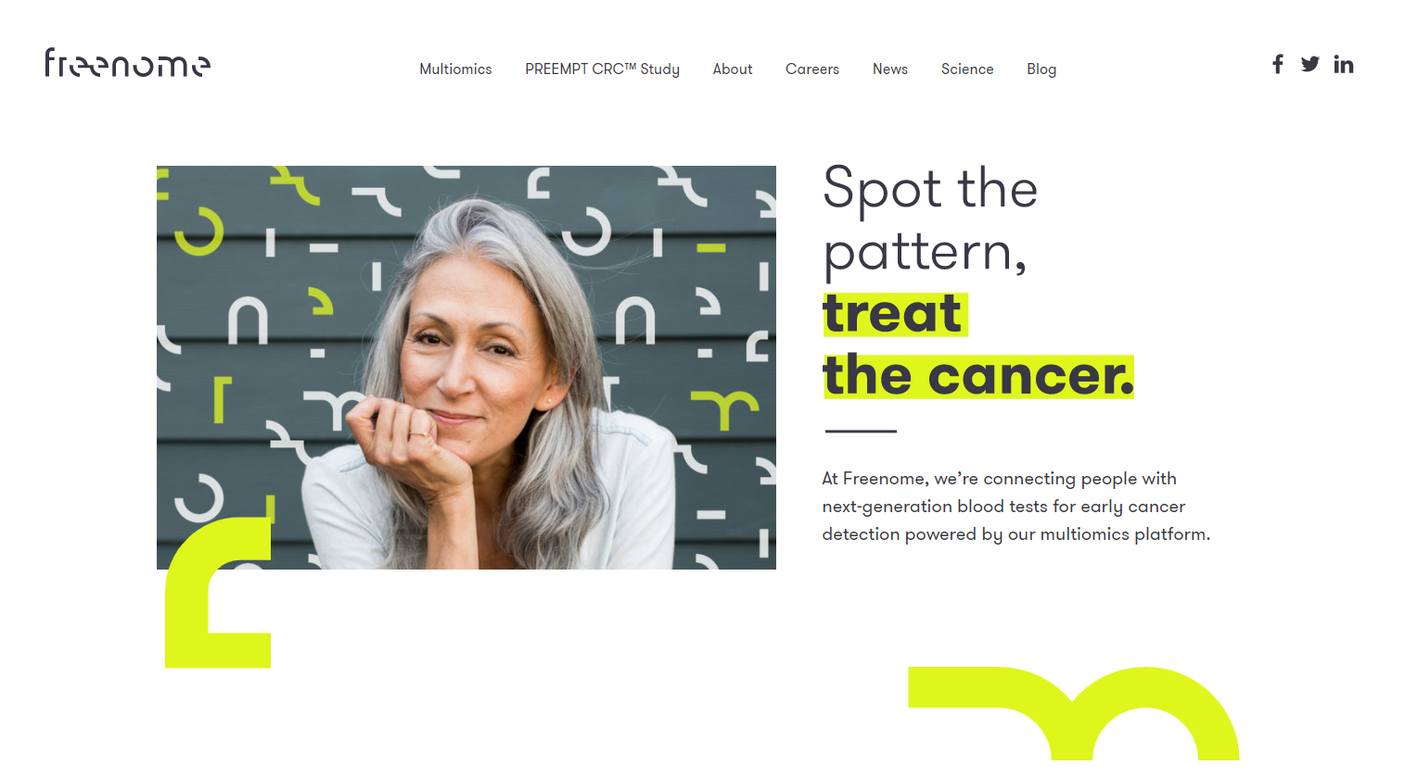


Why learn bioinformatics?
Gain many transferable skills!
Data science
Personalized medicine
NGO agency scientist
Undergraduate degree
Grad school
Postdoc
Professor
Research scientist in industry

